Slide 1
- TASK -MANAGEMENT APPLICATION
By :-
Akhil Y
J Deepak
C Shashank
Sameer Syed Akhmal

Slide 2

ABOUT
THE APPLICATION
Task Management Application is very similar to a To-Do List Application, where we can add, edit, manipulate, manage and also remove the tasks and it’s respective data. This application also contains extra features such as categorizing , giving priority and as also adding deadlines to the tasks

Slide 3


CODE OVERVIEW
Libraries:
We have used some of the standard libraries such for Unordered Map and Vector
Unordered_map is an efficient container for managing key-value pairs with average constant-time operations.
It is ideal for the to-do list application where task categories are dynamically managed.
Key Features:
A Menu for choosing operations with color coding (for better visualization of the text)
Dynamic task management based on user input.
Adding a Task
View tasks by Category
Input Handling

Slide 4
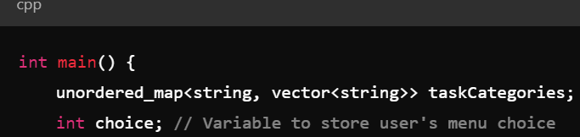
UNORDERED MAP
unordered_map<string, vector<string>> taskCategories;
Creates a map where keys are categories (strings) and values are vectors of task descriptions (strings). This allows for efficient lookups and categorization of tasks.

Slide 5
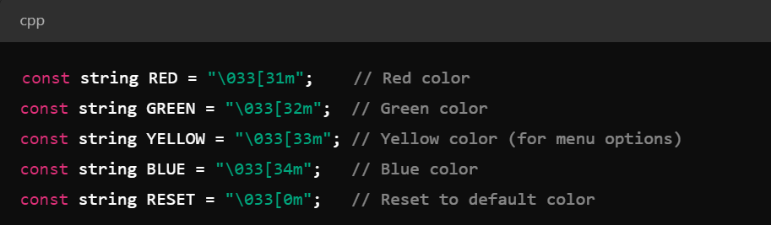
ANSI CODES
Defines ANSI escape codes for changing text color in terminal output. These codes are used to colorize text for better readability and to highlight different sections of the output.

Slide 6
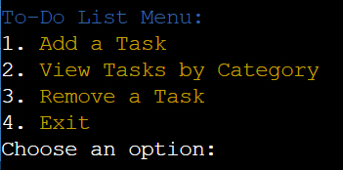
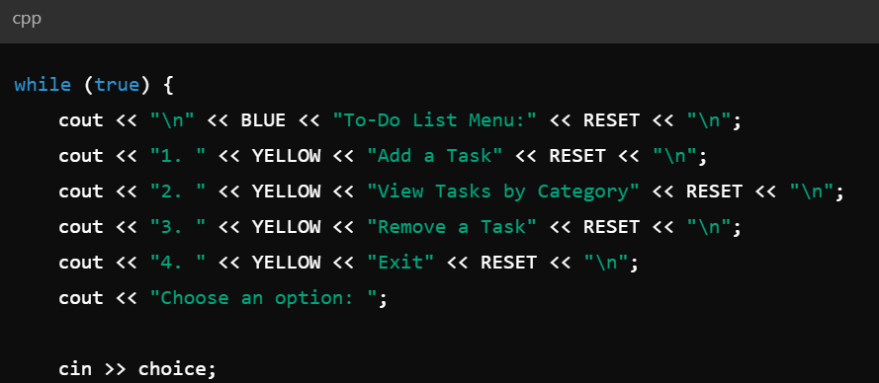
DISPLAY MENU
In this code , Input Handling woukd also be done
Displays the menu options to the user with color coding and prompts the user to choose an option. The menu runs in an infinite loop (while (true)) to allow the user interact continuously.

Slide 7
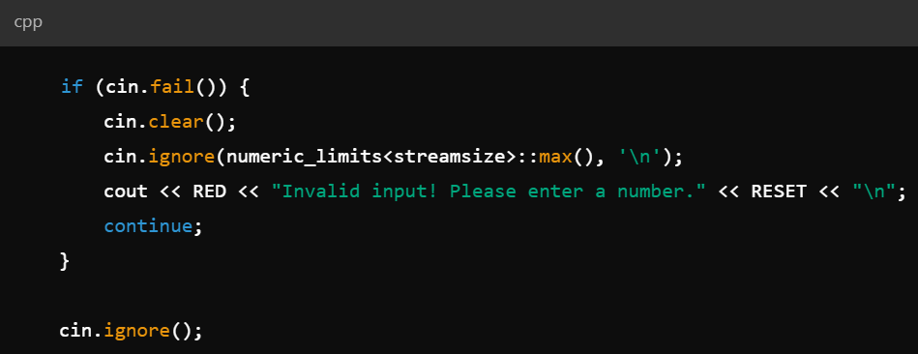
INPUT VALIDATION
Checks if the user input is valid. If not, it clears the error flag, ignores the invalid input, and prompts the user to enter a valid number

Slide 8
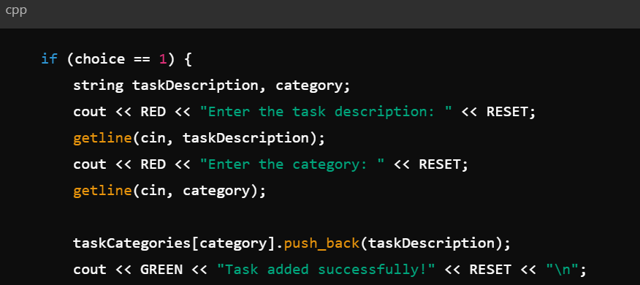
HANDLING MENU CHOICES
Adding a Task
Handles adding a new task. Reads the task description and category from the user, then adds the task to the specified category. Outputs a success message.

Slide 9
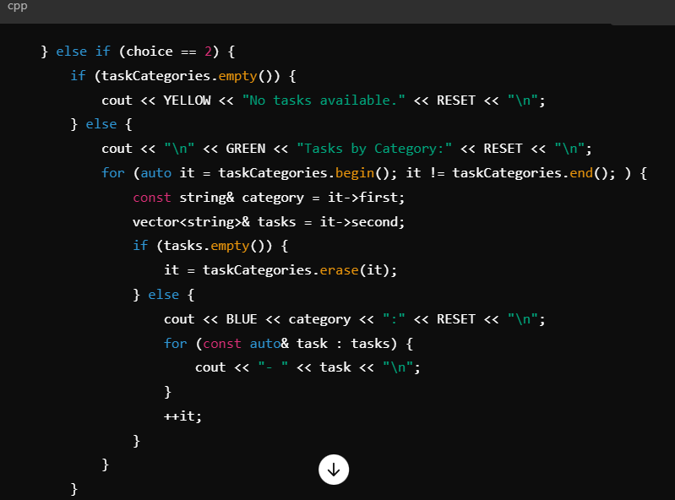
HANDLING MENU CHOICES
Viewing Tasks by Category
Displays tasks grouped by their categories. If no tasks are available, informs the user. Iterates through each category, displaying the tasks, and removes categories that have no tasks.

Slide 10
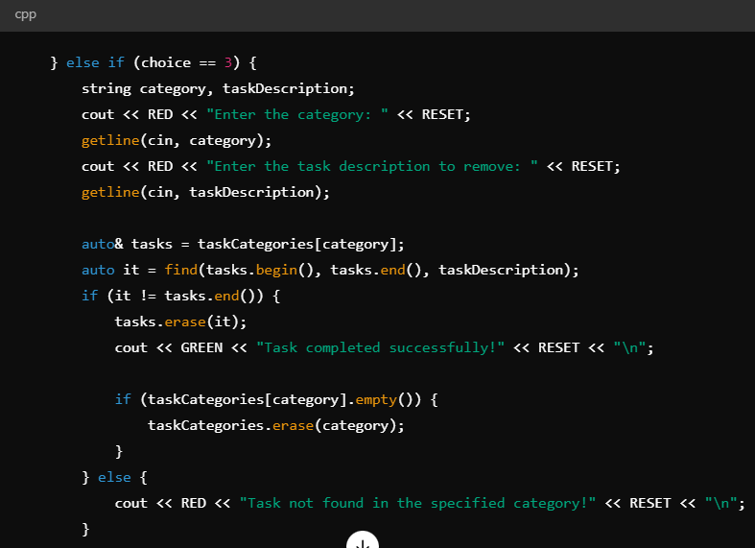
HANDLING MENU CHOICES
Removing Tasks
Handles the removal of a task. Reads the category and task description, then finds and removes the specified task. If the category becomes empty after removal, it is also deleted. Informs the user if the task was not found.

Slide 11
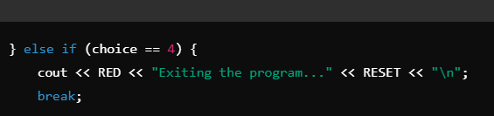
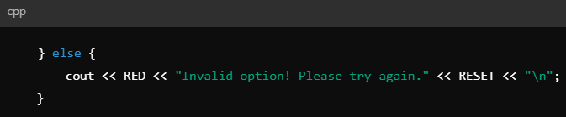
EXITING THE PROGRAM
Exits the program by breaking out of the while loop, thereby ending the program.
INVALID MENU OPTION
Handles invalid menu options by informing the user and prompting them to try again.

Slide 12
THANK YOU

